Slide 1
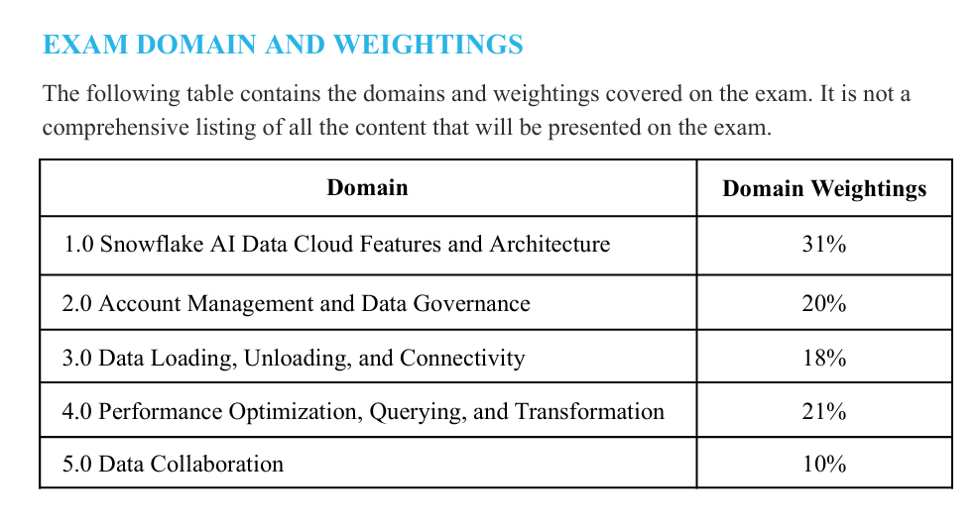
~71%

Slide 2
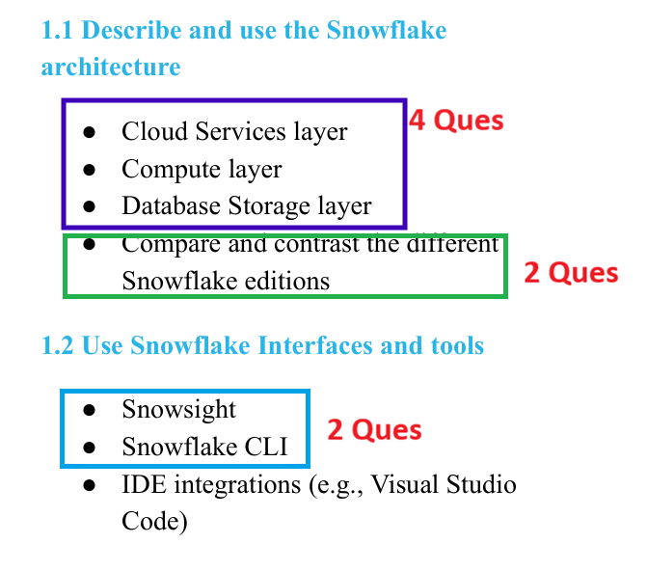
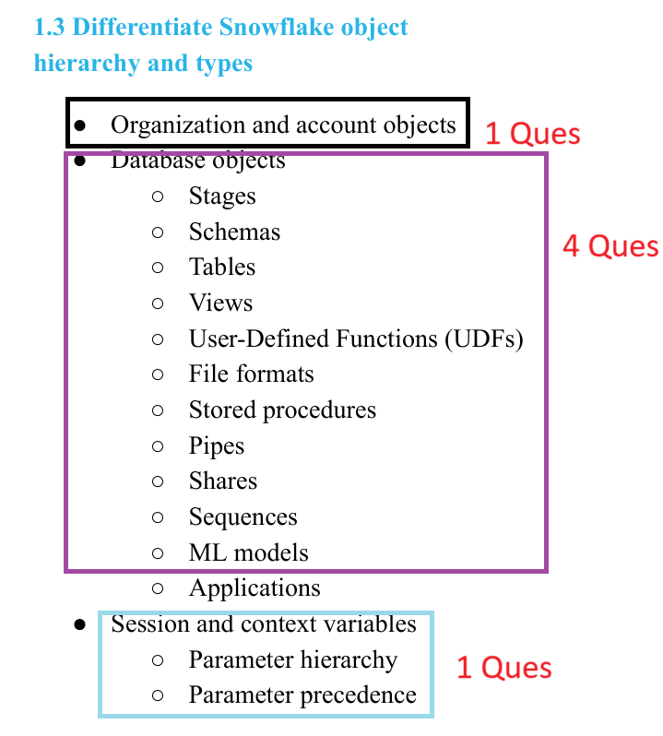

Slide 3
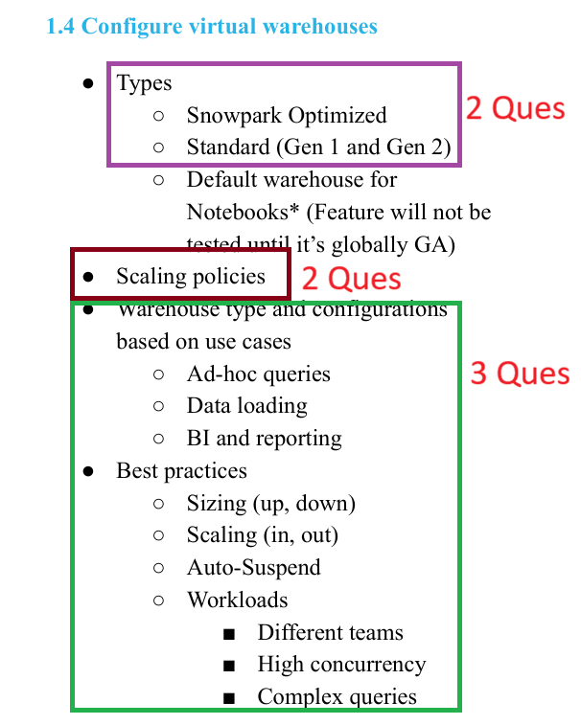
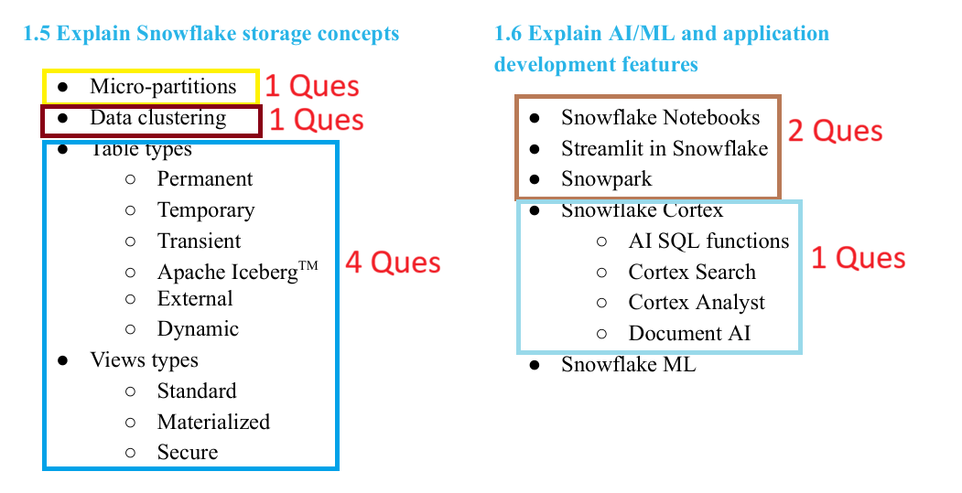

Slide 4
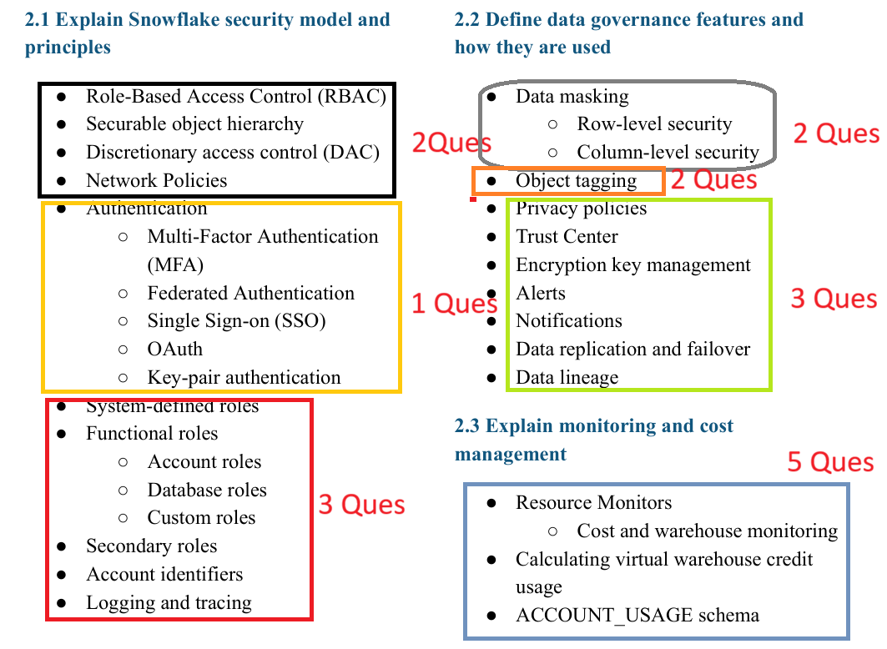

Slide 5
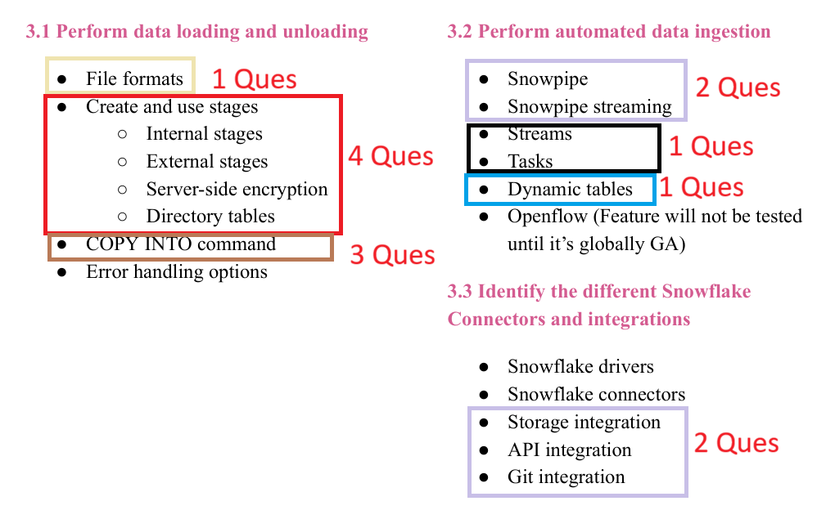

Slide 6
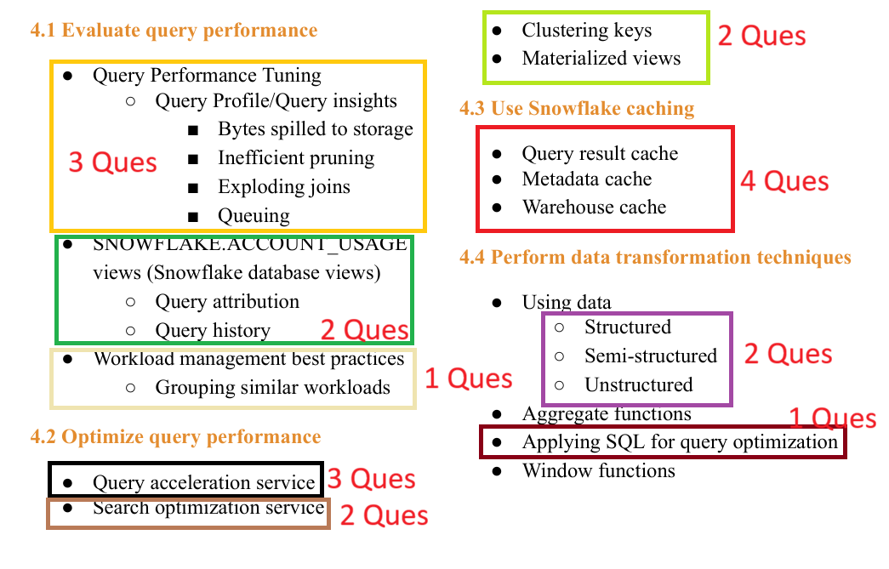

Slide 7
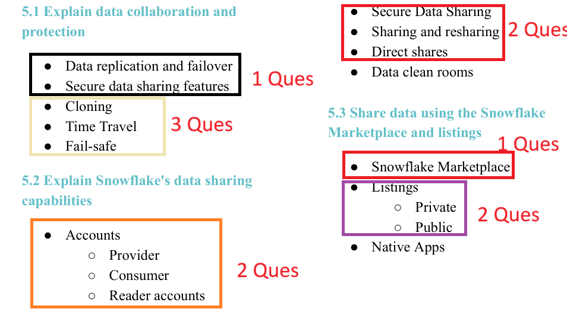

Slide 8

The 'Negative' Rule
Exam Question: A data architect is looking to scale a virtual warehouse to handle a massive, complex JOIN operation involving billions of rows. Which of the following statements is TRUE regarding Snowflake’s concurrency and scaling?
A. Snowflake requires a manual restart of the warehouse to change the size from Small to X-Large.
B. Multi-cluster warehouses can automatically scale out to handle increased concurrency without manual intervention.
C. Snowflake’s performance significantly degrades when more than 10 users query the same table simultaneously.
D. Data is physically moved between storage nodes every time a warehouse is resized, causing a temporary lock on the data.

Slide 9
The Relevance Filter
Sample Example: An administrator needs to ensure that a specific set of sensitive tables can only be queried by users in the HR_FULL_ACCESS role, regardless of which warehouse they are using. Which Snowflake feature should be used to satisfy this requirement?
A. Multi-cluster Warehouses
B. Object-level Access Control (RBAC)
C. Search Optimization Service
D. Resource Monitors

Slide 10
